Slide 1
Contributors
Forecasting Events of Severe Air Pollution In Delhi using Temporal Point Process
Ritvik Vij, IIT Delhi
Vinayak Gupta, IIT Delhi
Srikanta Bedathur, IIT Delhi

Slide 2
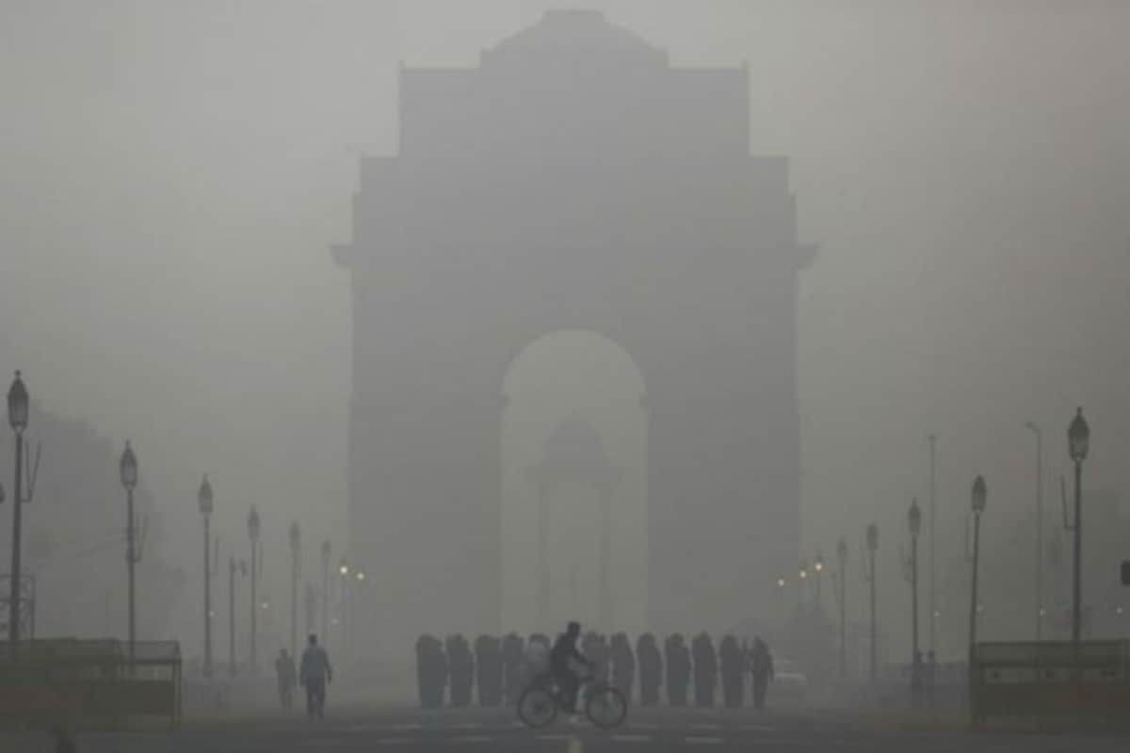
Pollution In Delhi-NCR
Delhi was voted as the most polluted capital city in the world for the last decade.
Pollution levels in Delhi have skyrocketed with the peak PM2.5 values in winter months (Nov-Jan) increased by 125% over the last decade.

Slide 3
Problem Statement
Our aim is to forecast events of “severe” air pollution in different regions of Delhi during a fixed horizon at a high spatial resolution and with high recall. We believe that forecasting such events can help the local authorities in making timely decisions to prevents such events from occurring and make Delhi a liveable city.
Recent literature in the context of Air Pollution Forecasting are designed for static sensor pollution data where a large portion of the readings for pollutant values are available after fixed intervals of time. Lack of the number of static sensors across the city provides readings at a low spatial resolution. Currently we rely on mobile sensor data to make useful predictions at a smaller scale and hence we need a novel approach that can work with such kinds of data.

Slide 4
Delhi Pollution Dataset
The Delhi Pollution Dataset is a Particulate Matter (PM) dataset for
Delhi-NCR which contains PM data recorded over three months from Nov 20 - Jan 21 spanning 560 square KMs.
The data is collected using vehicle-mounted IOT sensors deployed in the Delhi public buses giving us an extensive mobile sensor dataset that can be used to provide insights at very high resolutions across the city.

Slide 5
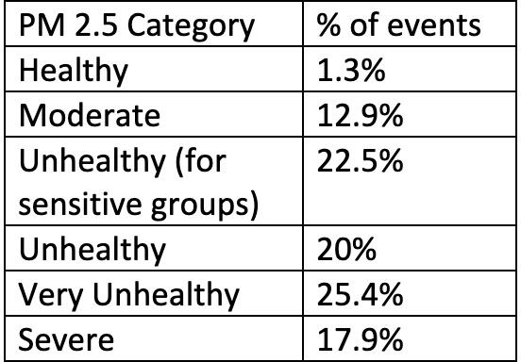
Data Preparation
We divide the regions of the city into (75*75) small grids of sizes ~0.1 km². Any sensor reading that falls within the boundaries of the grid is binned as an event of that grid. For a grid, we take the mean of all PM2.5 readings in a 3-hr window and then bin the pollutant values into 6 categories based on ¹
Each small grid now has a sequence of events. We filter out any grid where the
|sequence| < 10.
Number of grid sequences - 652
% of missing data in the time series - 67.5%
1 - https://aqicn.org/faq/2013-09-09/revised-pm25-aqi-breakpoints/

Slide 6
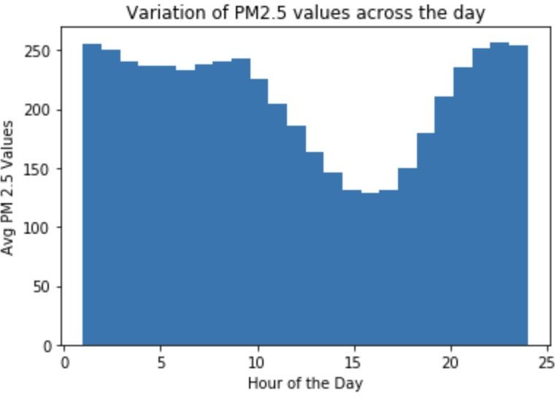
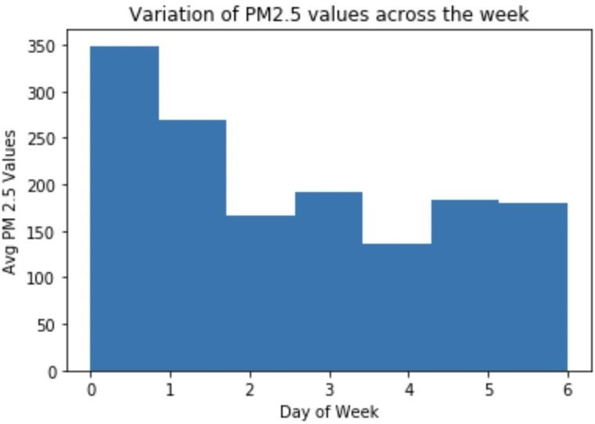
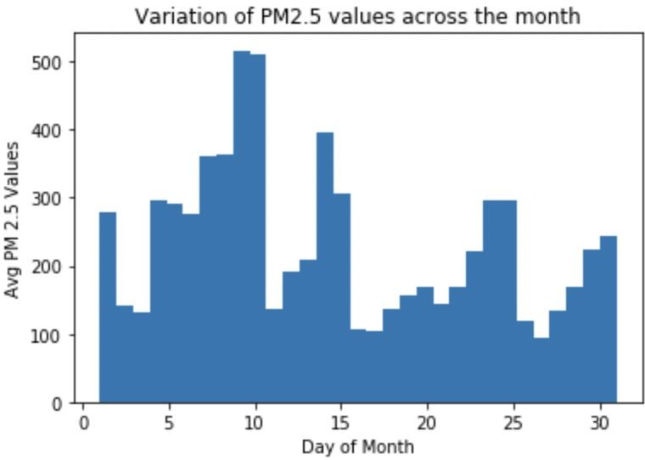
Identifying Patterns in Data
We try to identify the presence of two kinds of contextual information in our dataset -
Grid / Sequence Level - We plan to use geographical features that impact air quality such as the grid proximity to factories, major highways and buildings. Such information can be crawled from OpenStreetView Python API.
Event Level - We perform EDA and identify the presence of 3 temporal features to be used as context/metadata with each event.
Note that the sharp variation in PM2.5 values across days of the month might be due to intermittent

Slide 7
Evaluating Forecasting Results
We introduce a new metric - an overloaded version of the Wasserstein Distance to evaluate the performance of our forecasting models.
Let H, H’ be the list of true event times and corresponding predicted event times for severe air pollution in a fixed horizon. WLOG let us assume that |H| < |H’|, then -
where T_{e} is the end time of the forecasting horizon.

Slide 8
Simple Baselines
We introduce two very simple baselines -
Baseline 1 - Predict point estimates in the forecasting horizon at fixed intervals = mean inter-arrival time between events of severe pollution.
Baseline 2 - Predict point estimates in the forecasting horizon at intervals sampled from a normal distribution (per grid) constructed from the inter-arrival times between events of severe pollution.
We evaluate these simple baselines by keeping the known events for the first (N-K) days and forecast for the next K=(1,2,3) days.
Model | WassDist (1 Day) | WassDist (2 Days) | WassDist (3 Days)
Baseline 1 | 0.032 | 0.088 | 0.350
Baseline 2 | 0.061 | 0.241 | 0.621
The scale of the timestamps are 0 - 10 after min-max normalisation

Slide 9
Darts - Time Series Pylib
Darts is a Python Library for easy manipulation and forecasting of time series. We use two kinds of inbuilt deep learning models - N-beats and Temporal Fusion Transformer.In addition to using the raw data, we also experiment with using “imputed” data using the MICE algorithm for training the darts models.
Model | Data Imputation | WassDist (1 Day) | WassDist (2 Days) | WassDist (3 Days)
NBeats | No | 0.246 | 0.274 | 0.512
TFT | No | 0.134 | 0.196 | 0.317
NBeats | Yes | 0.283 | 0.443 | 0.677
TFT | Yes | 0.178 | 0.321 | 0.408
Darts allows the usage of covariate series along with the usage of target series which we are forecasting. We use the series of K=(8) neighbouring grids as the past covariate series. Results are below -
Model | Data Imputation | WassDist (1 Day) | WassDist (2 Days) | WassDist (3 Days)
NBeats + Negs | No | 0.193 | 0.255 | 0.407
TFT + Negs | No | 0.102 | 0.168 | 0.248

Slide 10




Temporal Point Process
Temporal Point Process (TPPs) are state-of-the-art models for learning timestamped event-streams.
Event sequence :
Time : and discrete mark :
Historical events influence future :
Popular SOTA marked TPP models -
THP - An intensity based TPP model that leverages the self-attention mechanism to capture the long term dependencies in it’s historical embeddings.
IFL - An intensity free TPP model that learns the distribution of event-time instead of inter-event time using first a) normalising flows and secondly b) mixture of log-normal distributions.
TPP models are traditionally evaluated using metrics such as MAE/RMSE and accuracy % for the next time and mark prediction. Models such as IFL instead use make comparisons using the Log-Likelihood for the test data.

Slide 11
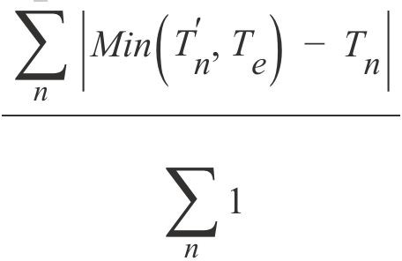
Temporal Point Process - Continued
Similar to the evaluations done in THP, we also predict only the next event of severe air pollution. For a sequence with multiple such severe pollution events in the horizon, we make those many predictions as the number of those events. This evaluation is done in a progressive validation manner.
We use an overloaded MAE => MAE’ =
Model | MAE’ (3 Days)
Baseline 1 | 0.091
Baseline 2 | 0.114
IFL | 0.058
THP | 0.074

Slide 12
Temporal Point Process - Continued
Next, we sample whole sequences in the horizon using our TPP models instead of just the next point. We train the point process models with the sequences from all grids for the first (N-K) days and sample points for the next K days. From the sampled points, we simply filter out the points with severe air pollution category and evaluate. Note that the sampled points are re-binned into the discrete time space of true events as TPP considers time to be continuous whereas our timestamps are discrete.
Model | WassDist (1 Day) | WassDist (2 Days) | WassDist (3 Days)
IFL | 0.042 | 0.149 | 0.271
THP | 0.144 | 0.227 | 0.413

Slide 13

Capturing Impacts of Other Grids
While the parameters of a marked temporal point process are unique for all sequences and help in capturing the global dynamics, they do not work well in capturing the impact of historical events across multiple sequences.
In addition to accounting for the historical pollution trends in a location, a good pollution forecasting engine needs to account for the impact of recent pollution trends in neighbouring locations as well overall trends in the city.
We propose an attention-based model that works in parallel with the MTPP to capture the impact of local/global grids. Mathematically -
- Eq (1)
The output of this model will be infused with the output of the TPP hidden embedding to perform the point estimation.

Slide 14
Modified Attention Model
In Eq (1), we account for the impact of pollution in a locality at timestep t by the other surrounding grids at timestep (t-1). We believe that the pollution levels can be impacted with a lag more than the timestep (3 hours), especially by those grids which are farther away from the locality (not neighbouring grids). We find the evidence of such occurrences and make the necessary modifications to Eq (1).
- (Eq 2)
Baseline 3 - LSTM+Attention
In addition to capturing the impact of other grids in the city using our attention model, we add a LSTM that captures the impact of the past pollution levels in the current grid. This model is purely built as a baseline to evaluate how well our point process model can capture the impact of historical events in comparison to an LSTM cell.

Slide 15
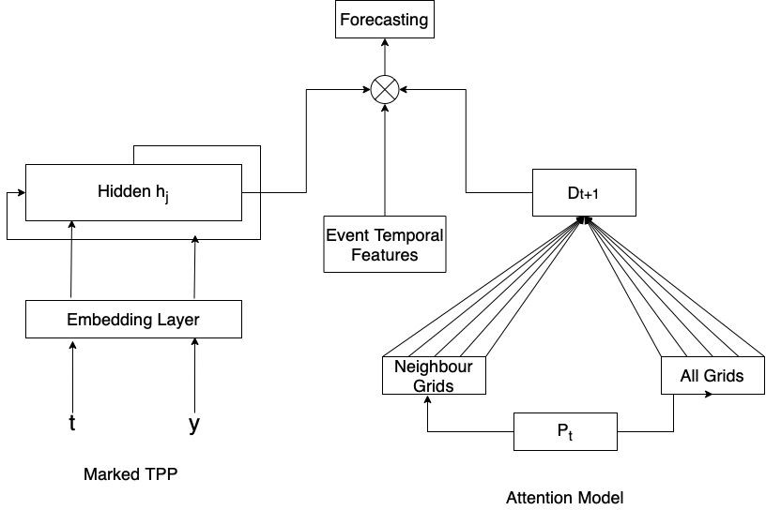
Proposed Model

Slide 16
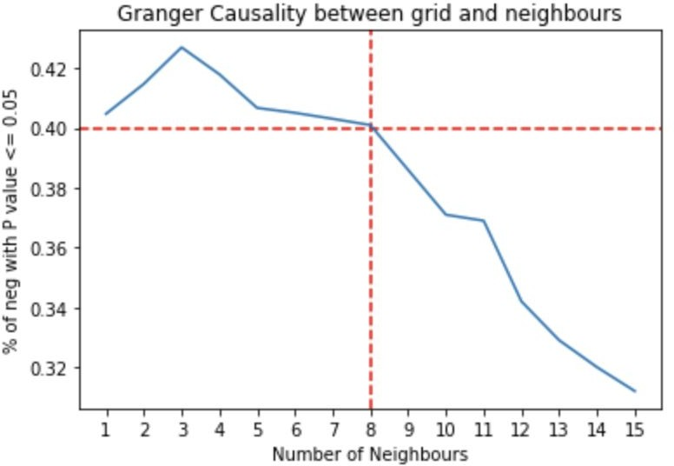
EDA For Attention Model
We first try to find the best number of K neighbourhood grids where the impact of pollutants value at timestep T by the neighbouring grids is the highest for the current grid.
We find the mean granger causality between the sequence of the current grid and closest K neighbourhood grids. We perform the F-test and find the % of grid-neighbour pairs that have P-value <=
0.05 (sign of causality). We use 40% as a cut-off and hence experiment with K=8 closest neighbouring grids for each grid.
Similarly, we divide the whole city into 9 mega-grids based on their lat and long. For example, a grid with location (lat, long) will lie in the mega-grid – [3*(long-max_long) // 25 + (lat – max_lat) // 25].
We assign the PM2.5 level category by performing max-voting of all grids in a mega-grid with non-zero PM2.5 level category readings.
When there are no readings for any grid in the mega-grid, we assign the category as 0 (missing).

Slide 17
Evaluating Attention Model
We build two types of stand-alone attention models - (a) regression model that predicts the exact PM
2.5 readings (b) classification model that predicts the category of pollution based on the category readings of neighbours and the whole city at the previous step.
Attention Model | Task Type | WassDist (1 Day) | WassDist (2 Days) | WassDist (3 Days)
Local | Regression | 0.052 | 0.178 | 0.472
Local | Classification | 0.020 | 0.071 | 0.263
Local + Global | Regression | 0.031 | 0.126 | 0.284
Local + Global | Classification | 0.017 | 0.064 | 0.242
Next, we train and evaluate the modified attention model as per (eq 2). The neighbouring grids now account for one timestep more (upto 6 hours prior) and the mega-grids now account for 3 timesteps more (upto 12 hours prior).
Attention Model | Task Type | WassDist (1 Day) | WassDist (2 Days) | WassDist (3 Days)
Local | Regression | 0.052 | 0.178 | 0.472
Local | Classification | 0.020 | 0.071 | 0.263
Local + Global | Regression | 0.031 | 0.126 | 0.284
Local + Global | Classification | 0.017 | 0.064 | 0.242

Slide 18
Results on Proposed Model
We next present the results with our propose model in Slide 15. For all these experiments, we use the attention model with classification task type.
To infuse the neighbourhood representation feature and temporal features with the historical embedding, we experiment with three kinds of operations - a) simple addition b) concatenation and then regression c) latent cross - a novel operator used in YouTube recommendations. We present results with infusion using latent cross only as they give the best WassDist scores.
Model | WassDist (1 Day) | WassDist (2 Day) | WassDist (3 Day)
Baseline 3 | 0.022 | 0.069 | 0.230
IFL + Attention | 0.026 | 0.087 | 0.252
THP + Attention | 0.102 | 0.168 | 0.322
IFL + Attention + Features | 0.023 | 0.079 | 0.227
THP + Attention + Features | 0.109 | 0.184 | 0.344

Slide 19
Future Work
Identify forecasting models used by domain experts and benchmark our model against domain-specific measures with physical meaning.
Incorporate techniques used by industry experts to make our model more robust.
Identify more event-level features to infuse, additionally crawl sequence-level features and design a way to incorporate them in our model.
Try to solve the problem of interpolation in this context and study if it has the ability to improve our forecasting engines.

Slide 20

THANK YOU!

